Slide 1
Digital Portfolio
STUDENT NAME: RAJALAKSHMI P
REGISTER NO AND NMID: 212401024 / 2FB24698E7B2F6D97AC48840C4C659F4
DEPARTMENT: COMPUTER APPLICATIONS
COLLEGE: UNIVERSITY OF MADRAS

Slide 2
PROJECT TITLE DIGITAL PORTFOLIO USING FRONT END DEVELOPMENT

Slide 3


AGENDA
Problem Statement
Project Overview
End Users
Tools and Technologies
Portfolio design and Layout
Features and Functionality
Results and Screenshots
Conclusion
Github Link
3/21/2024 Annual Review

Slide 4

PROBLEM STATEMENT
Traditional resumes and printed portfolios are often limited, outdated, and fail to demonstrate technical or creative abilities effectively. Recruiters and employers increasingly expect candidates to have a digital presence that reflects their knowledge of technology and design.
However, many individuals struggle to present their work in an engaging, interactive, and easily accessible format. Without a digital portfolio, opportunities may be missed due to lack of visibility or poor presentation of skills.
Therefore, there is a need for a digital portfolio built with front-end development technologies (HTML, CSS, JavaScript) that is user-friendly, responsive, visually appealing, and accessible online. This will allow individuals to showcase their professional journey, skills, and projects effectively, making a strong impression on potential employers, clients, and academic institutions.

Slide 5

PROJECT OVERVIEW
The Digital Portfolio is a personal website developed using front-end technologies (HTML, CSS, and JavaScript) to provide a professional platform for showcasing skills, academic achievements, projects, and experiences. Unlike a traditional paper-based resume, this portfolio is interactive, responsive, and accessible online, making it easier for employers, educators, and peers to explore an individual’s capabilities.
The portfolio is designed with a clean user interface and responsive layout, ensuring that it works seamlessly across different devices such as desktops, tablets, and smartphones. It includes key sections like About Me, Skills, Projects, Resume, and Contact Information, allowing visitors to gain a complete overview of the individual’s professional and academic background.

Slide 6

WHO ARE THE END USERS?
The digital portfolio developed using front-end technologies is primarily intended for recruiters and employers, who can easily access and evaluate an individual’s skills, achievements, and projects when considering them for internships or job opportunities. It also serves as a valuable resource for college faculty and academic institutions, enabling them to review students’ academic work and technical skills during evaluations or assessments. Additionally, clients and potential collaborators can explore the portfolio to understand the individual’s capabilities before engaging in freelance projects or teamwork. At the same time, peers and fellow developers may use it as a point of reference for collaboration and learning. Finally, the portfolio is equally beneficial for the owner, as it acts as a personal branding tool and provides a professional online identity that enhances visibility and career opportunities.

Slide 7

TOOLS AND TECHNIQUES
The development of the digital portfolio makes use of modern front-end web technologies and design techniques to create an engaging and professional platform. The core tools include HTML (HyperText Markup Language) for structuring the content, CSS (Cascading Style Sheets) for designing the layout and styling the interface, and JavaScript for adding interactivity and enhancing the user experience.
For design and responsiveness, CSS Flexbox and Grid techniques are applied to ensure the portfolio adapts well to different devices such as desktops, tablets, and mobile phones. Media queries are used to implement responsive design principles. Additionally, animations and transitions are incorporated to make the portfolio visually appealing and interactive.

Slide 8
POTFOLIO DESIGN AND LAYOUT
A portfolio should be designed in a clean, structured, and user-friendly layout so that visitors can easily navigate and understand your skills and achievements. The design usually begins with a homepage or landing section, where your name, professional title, and a short tagline are highlighted, creating a strong first impression.
The layout then flows into an About Me section, giving a brief introduction, background, and career goals, often with an option to download the resume. Following this, a Skills section is included to display both technical and soft skills. These can be represented visually using icons, progress bars, or categorized lists to make the section engaging.

Slide 9
FEATURES AND FUNCTIONALITY
The portfolio website is designed with multiple features and functionalities that make it professional, user-friendly, and effective for showcasing personal skills and achievements. The homepage acts as the first point of interaction, displaying the individual’s name, professional title, and a clear navigation menu that guides visitors through the website. The About Me section provides a short introduction, career objectives, and a link to download the resume, helping recruiters quickly understand the candidate’s background. The Skills section highlights both technical expertise, such as programming languages and tools, and soft skills like teamwork and communication, often represented with icons or visual progress indicators for better readability. A dedicated Projects section showcases major academic and personal works with titles, descriptions, technologies used, screenshots, and GitHub or live demo links, allowing employers to see proof of work in action.

Slide 10
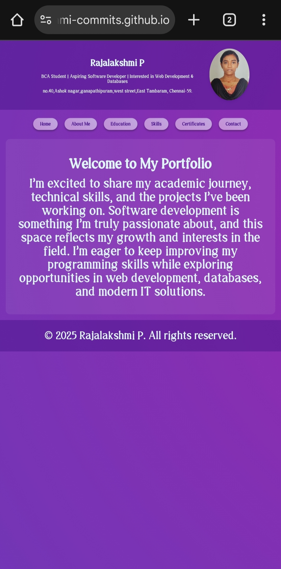

RESULTS AND SCREENSHOTS
The portfolio website was successfully designed and developed with a clean, responsive, and user-friendly interface. All the planned features such as Homepage, About, Skills, Projects, Certifications, and Contact sections were implemented effectively. The website allows smooth navigation, works seamlessly on desktop and mobile devices, and provides recruiters with easy access to the candidate’s information and project showcases. The inclusion of live project links, GitHub repositories, and downloadable resumes has enhanced the portfolio’s professional value. Overall, the project achieved its objective of creating a personal branding platform that highlights skills, achievements, and career aspirations.
3/21/2024 Annual Review

Slide 11
CONCLUSION
The portfolio website project successfully achieved its objective of creating a professional and user-friendly platform to showcase personal skills, projects, and achievements. By incorporating a clean design, responsive layout, and smooth navigation, the portfolio provides recruiters, collaborators, and academic mentors with easy access to relevant information. The integration of sections such as About Me, Skills, Projects, Certifications, and Contact ensures that the portfolio is both comprehensive and engaging.

Slide 12
Github Link https://rajalakshmi-commits.github.io/Rajalakshmi-/

